Slide 1
Sep 24, 2020
12.30 – 14.00

Slide 2
Creating a Community – we need your help!
Webcam: Turn on your webcam so we can see everyone​
Names: Rename yourself on Zoom to your preferred name/nickname

Slide 3
- Background – reason for being
- Breakout room #1 – Why you are here /challenges you have faced in facilitating intercultural learning experiences
Guest speaker – Mr. Willie Heung, HKUST Alumnus and Development Director for Li Po Chun, United World College of Hong Kong
What is a CoP?
Breakout room #2 - What do we want to achieve? how does this align with HKUST core values?
- Looking ahead – programme of future events and core Community membership/training opportunities

Slide 4
Looking ahead
Sep 24, 2020, 12.30 – 14.00 | Inaugural meeting (Guest speaker Willie Heung, HKUST Alumnus, Development Director, Li Po Chun United World College of Hong Kong)
Oct 27, 2020 12.30 – 14.00 | Regular meeting (with guest speaker – Till Kraemer, ICE)
Dec 9, 2020 12.00 – 14.00 | Training Workshop #1 (2 hours) – face to face?
Feb 2021 | Training Workshop #2 (2 hours)
Mar 2021 (lunchtime 1-1.5 hours) | Regular meeting/forum with LPCUWC staff and students (+ HKUST students/LPCUWC alumni)
April 2021 | Training Workshop #3 (2 hours)
May 2021 (lunchtime 1-1.5 hours) | Regular meeting – planning for next academic year
Please complete survey

Slide 5
Breakout Room #1 (10 minutes)
Please introduce yourself
Tell your groupmates
- Why you are here
- About any challenges you have faced in promoting positive and effective intercultural learning experiences (in the classroom/in co-curricular programmes etc.)
Be ready to introduce a group member to the larger group

Slide 6
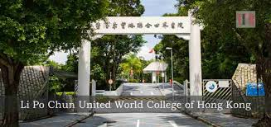
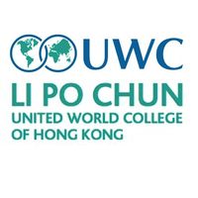
Mr Willie Heung
Development Director for Li Po Chun, United World College of Hong Kong

Slide 7
What is a CoP?

Slide 8
A CoP is not…
a committee or task force
an interest group
These structures can lack community and/or scholarship of teaching and learning (SoTL).

Slide 9
A community…
is both a feeling and a set of relationships among people. People form and maintain communities to meet common needs.
Members of a community… have an individual and collective sense that they can, as part of that community, influence their environments and each other.
(Chavis and Lee, 2015)

Slide 10
SoTL
SoTL invites professionals to examine their own classroom practice, record their successes and failures, and ultimately share their experiences so that others may reflect on their findings and build upon teaching and learning processes.
(Hutchings & Shulman, 1999)

Slide 11
A CoP is …
According to many, the most effective way of implementing evidence-based interventions and innovations in teaching and learning in higher education.

Slide 12
Membership
Coordinator: organises, advises, energises, champions, supports, sustains…
3 possible levels of participation:
The core group
The active group
The peripheral group
We need others to complement and develop our own expertise.
The experience people have to share is clearly important. But communities of practice also innovate and solve problems. They invent new practices, create new knowledge, define new territory, and develop a collective and strategic voice.
(Wenger, 1998)

Slide 13
This CoP will be…
A university-wide community, promoting:
reflection on the coherence of learning across disciplines
collaboration across disciplines
SoTL

Slide 14
Breakout Room #2 (20 minutes)
What do we want to achieve?
What do we want to share/learn about?
Specific goals for achieving our mission?
Why/how does this align with HKUST strategy/vision/mission/core values?

Slide 15
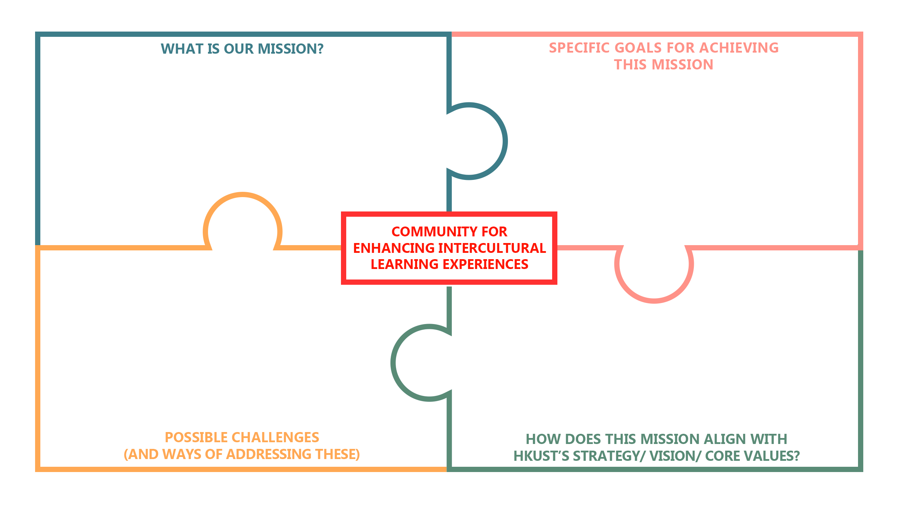
Please Type Here
Please Type Here
Please Type Here
Please Type Here
Please Type Here
Please Type Here
Please Type Here
Please Type Here

Slide 16
Looking ahead
Sep 24, 2020, 12.30 – 14.00 | Inaugural meeting (Guest speaker Willie Heung, HKUST Alumnus, Development Director, Li Po Chun United World College of Hong Kong)
Oct 27, 2020 12.30 – 14.00 | Regular meeting (with guest speaker – Till Kraemer, ICE)
Dec 9, 2020 12.00 – 14.00 | Training Workshop #1 (2 hours) – face to face?
Feb 2021 | Training Workshop #2 (2 hours)
Mar 2021 (lunchtime 1-1.5 hours) | Regular meeting/forum with LPCUWC staff and students (+ HKUST students/LPCUWC alumni)
April 2021 | Training Workshop #3 (2 hours)
May 2021 (lunchtime 1-1.5 hours) | Regular meeting – planning for next academic year
Please complete survey

Slide 18
3 Training Sessions
1. Introduction to Intercultural Experiences: Diversity Dialogue
2. Deepening the Cultural Dialogue
3. Intentional Action - Facilitation Design

